Slide 1
NCAA Tournament Machine Learning

Slide 2

What is Machine Learning?

Slide 3
Purpose
The purpose of this lunch and learn is for attendees to gain a deeper understanding of what is involved in machine learning
Not how to code
Not which machine learning algorithms are “best”
Not to win NCAA tournament pools

Slide 4

Official Competition

Slide 5

Use Jupyter Notebooks

Slide 6
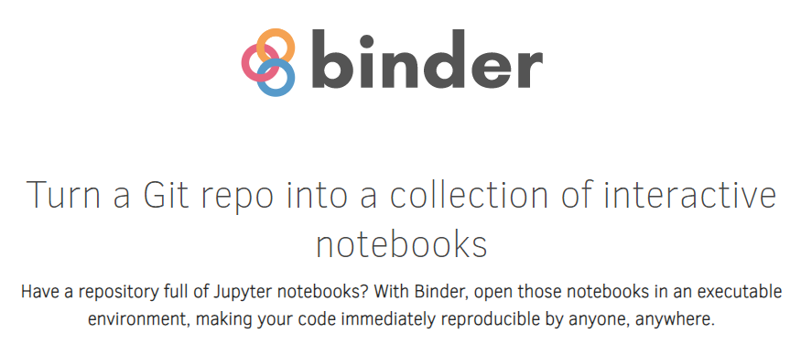
Binder allows running Jupyter Notebooks in the cloud

Slide 7
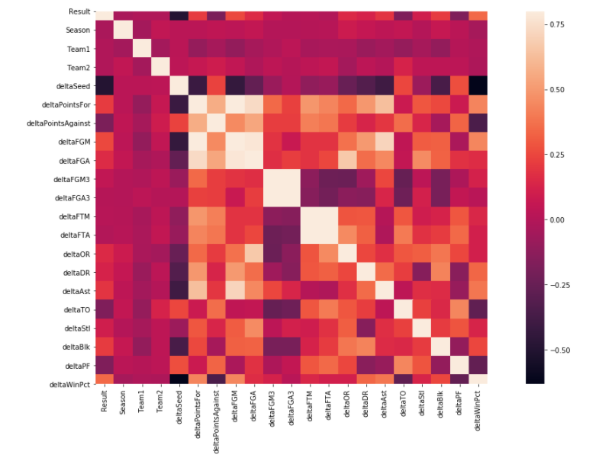
Correlations Between Features

Slide 8
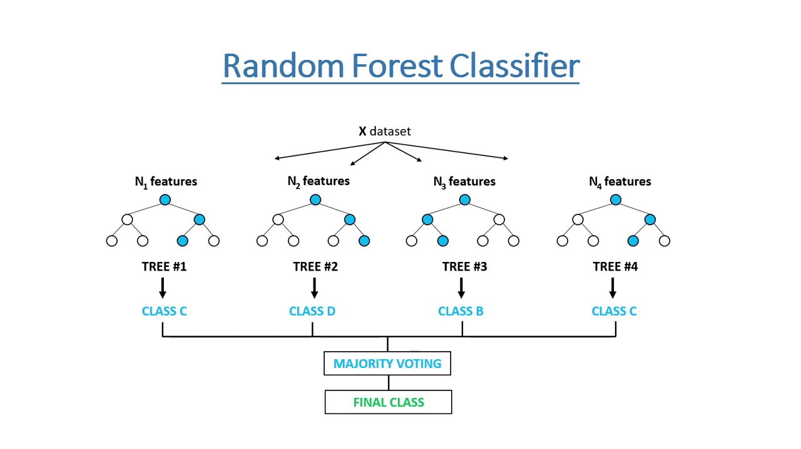

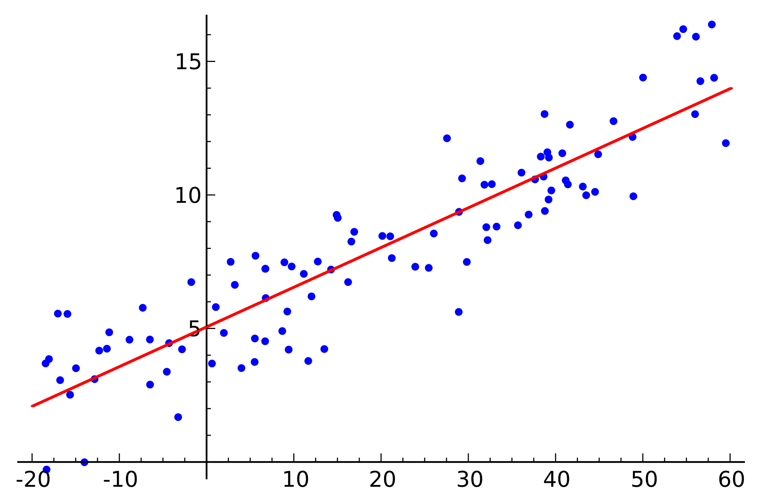
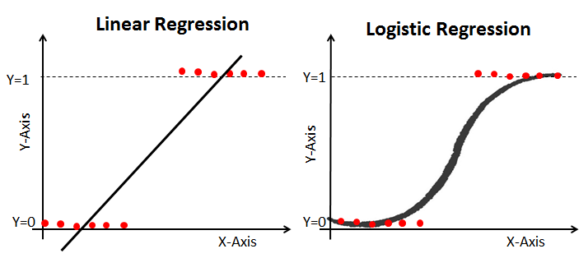
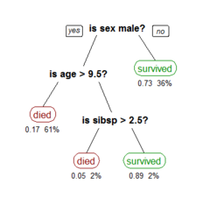
Explore Several Types of Models
Neural Network
Random Forest Classifier
Linear Regression
Logistic Regression
Decision Tree Classifier

Slide 9
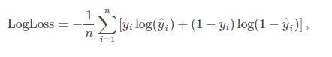
Contest Part 1 – Log Loss of Predictions
ID | Pred
2019_1101_1113 | 0.6
2019_1101_1120 | 0.2
2019_1101_1124 | 0.5
2019_1101_1125 | 0.5
2019_1101_1133 | 0.9
2019_1101_1138 | 0
2019_1101_1153 | 0.1
2019_1101_1159 | 0.7
2019_1101_1181 | 0
2019_1101_1192 | 0.8
2019_1101_1196 | 0.5
2019_1101_1199 | 0.4
2019_1101_1205 | 0.8
2019_1101_1209 | 0.6
2019_1101_1211 | 0
2019_1101_1222 | 0.1
2019_1101_1233 | 0.6
2019_1101_1234 | 0.4
2019_1101_1235 | 0.1
2019_1101_1242 | 0.2
2019_1101_1243 | 0.1
2019_1101_1246 | 0
2019_1101_1251 | 0.5
2019_1101_1257 | 0
n is the number of games played
y^i is the predicted probability of team 1 beating team 2
yi is 1 if team 1 wins, 0 if team 2 wins
log() is the natural (base e) logarithm
*2279 combinations

Slide 10
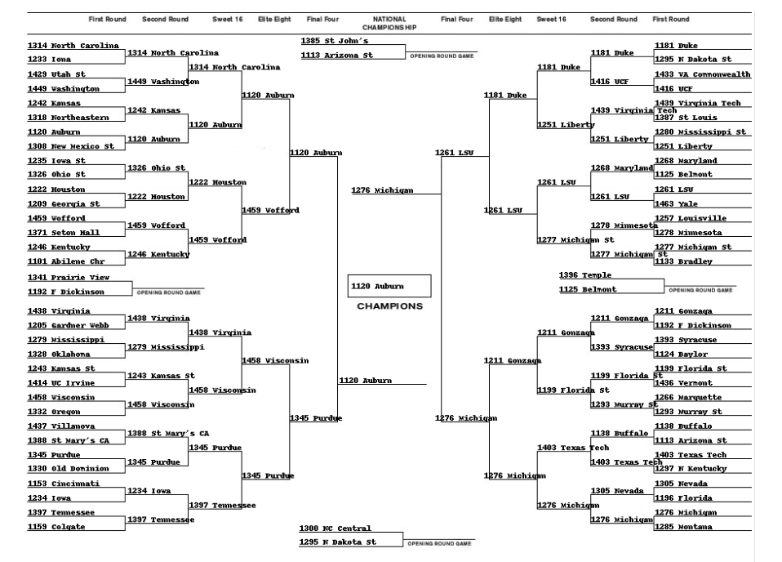
Contest Part 2 – Bracket

Slide 11

Questions?

Slide 12
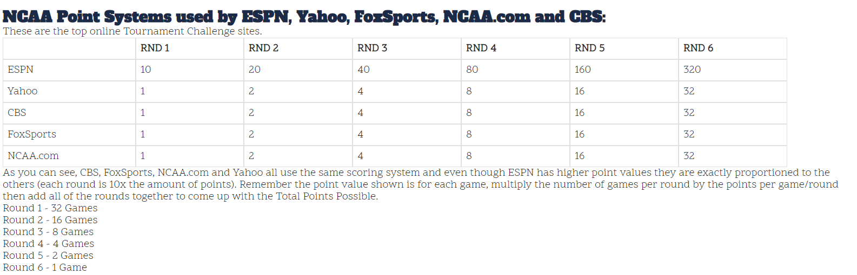
Contest Part 2 – Bracket

Slide 13
Link to notebook
https://mybinder.org/v2/gh/thekevster08/MarchMadness/master

Slide 14
Quick Disclaimer
This is a difficult problem (especially first problem)
Do not bet money with this bracket. You will lose

Slide 15
Cut to notebook
Link here:
https://mybinder.org/v2/gh/thekevster08/MarchMadness/master

Slide 16
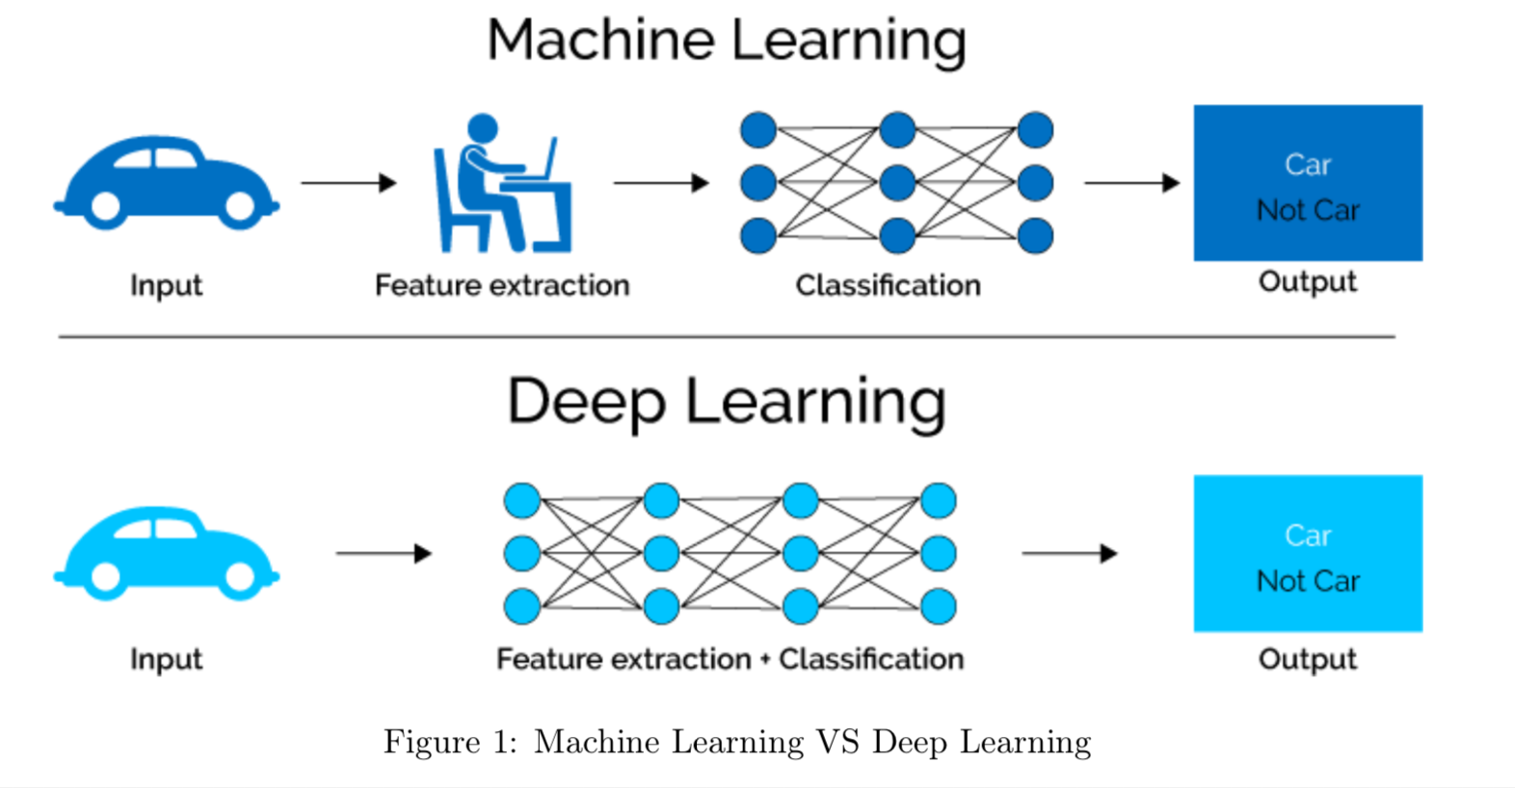
What is Machine Learning?

Slide 17

Types of Machine Learning
Notes:
We are going to be working in the supervised learning space. This is made up of classification and regression. Classificatoin is if you want to know if something belongs to a category. Say you are coming up with an algorithm to determine the picture is a dog or a cat. Or is it a hot dog?

Slide 18
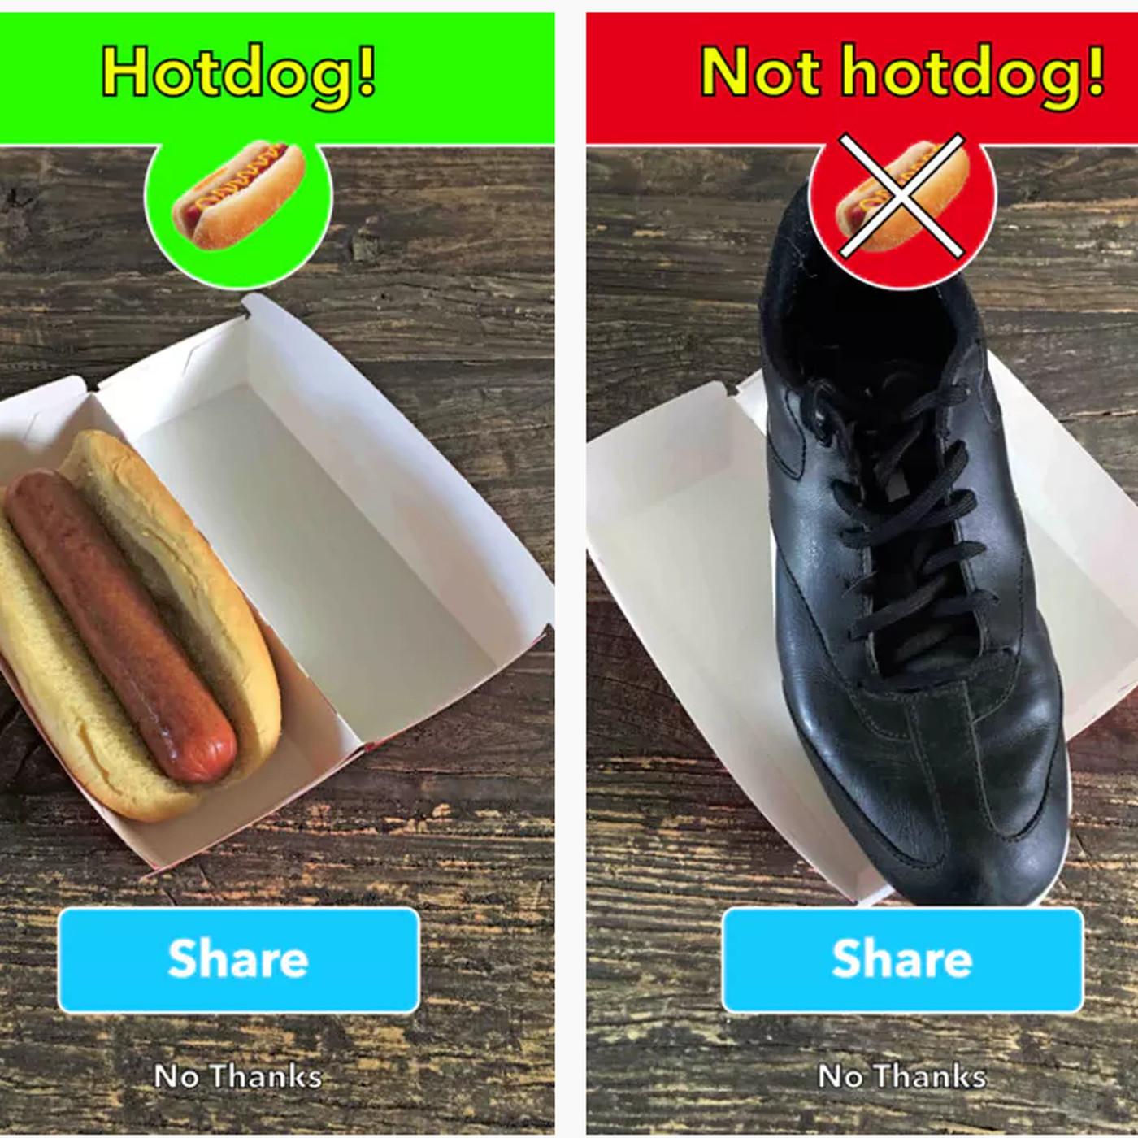

Example of Classification

Slide 19

isthisacat.com

Slide 20
Example of Regression

Slide 21
Back to notebook

Slide 22

We will be using scikit learn

Slide 23


Major Machine Learning Libraries

Slide 24
Back to notebok

Slide 25
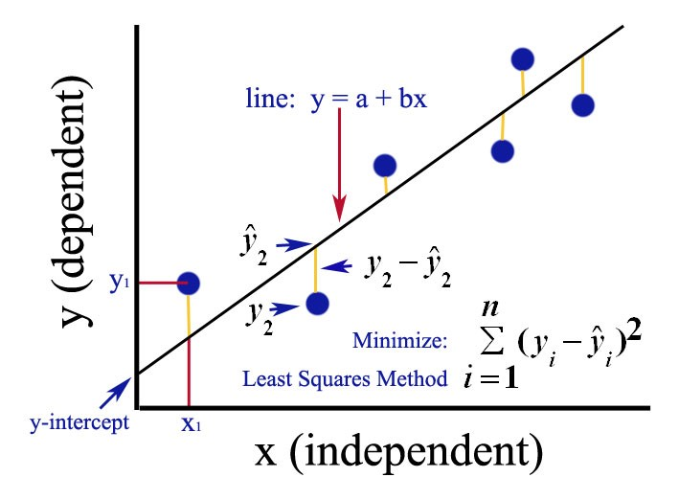
Ordinary Least Squares

Slide 26
Back to notebook

Slide 27
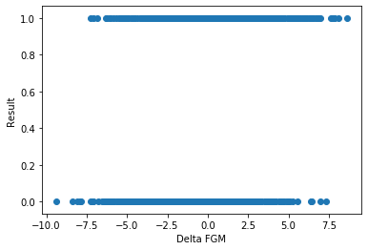
Recall Categorical Data

Slide 28

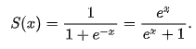
Sigmoid Function

Slide 29
Logistic Regression

Slide 30
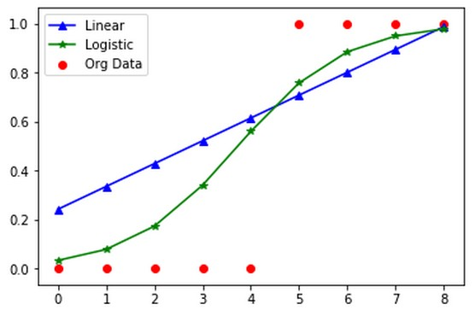

Slide 31
Back to notebook

Slide 32
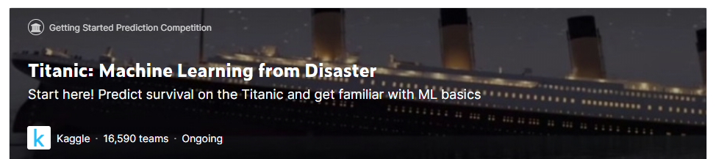
Kaggle – Titanic Challenge

Slide 33
Decision Tree Classifier

Slide 34
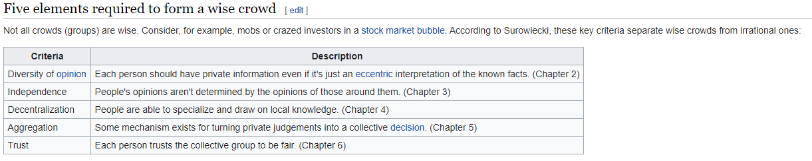
Wisdom of Crowds

Slide 35
Random Forest Classifier

Slide 36
Back to notebook

Slide 37
What is deep learning?

Slide 38
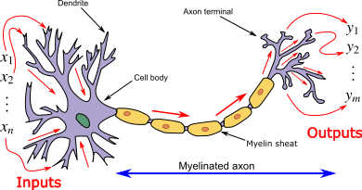
A neural network mimics an actual neuron

Slide 39
Neural Network Architecture

Slide 40
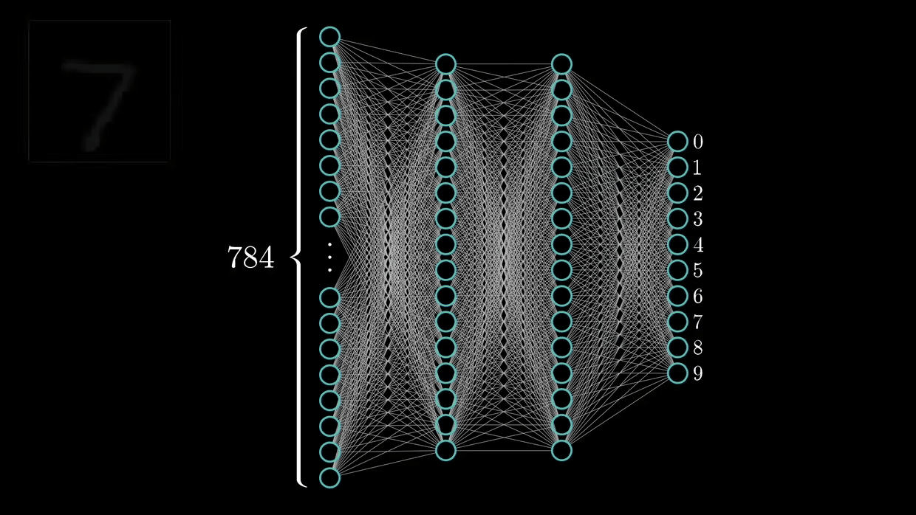
Training a Neural Network

Slide 41
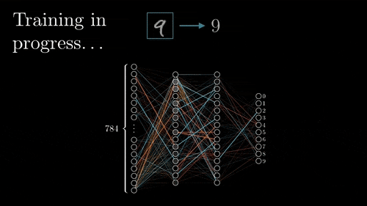
Back Propogation

Slide 42
To notebook

Slide 43
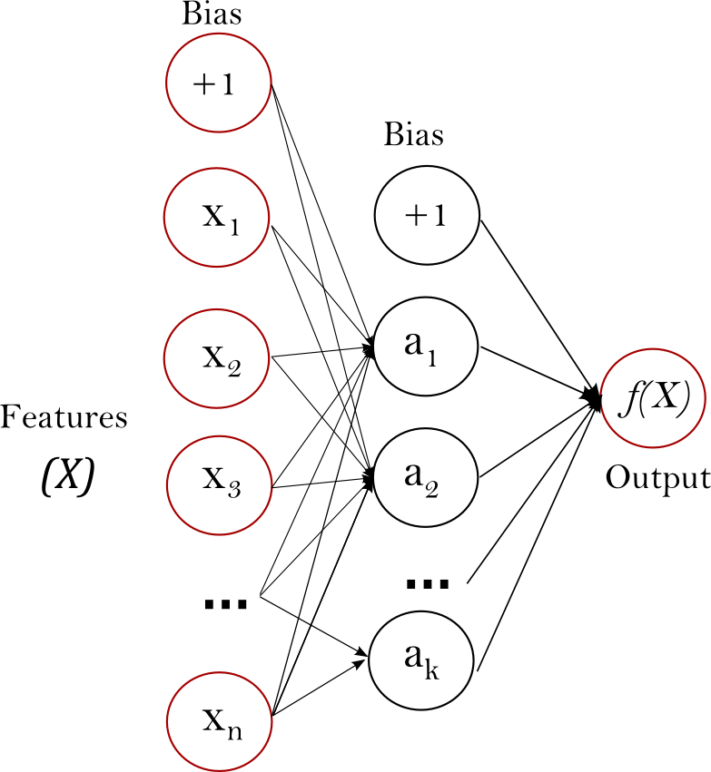
Scale Your Features!

Slide 44
To notebook

Slide 45
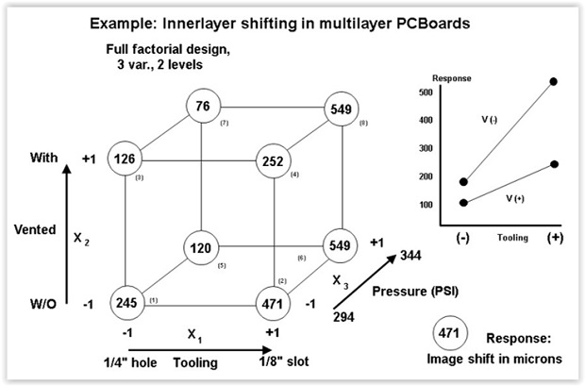
DOE Fundamentals

Slide 46
To Notebook

Slide 47
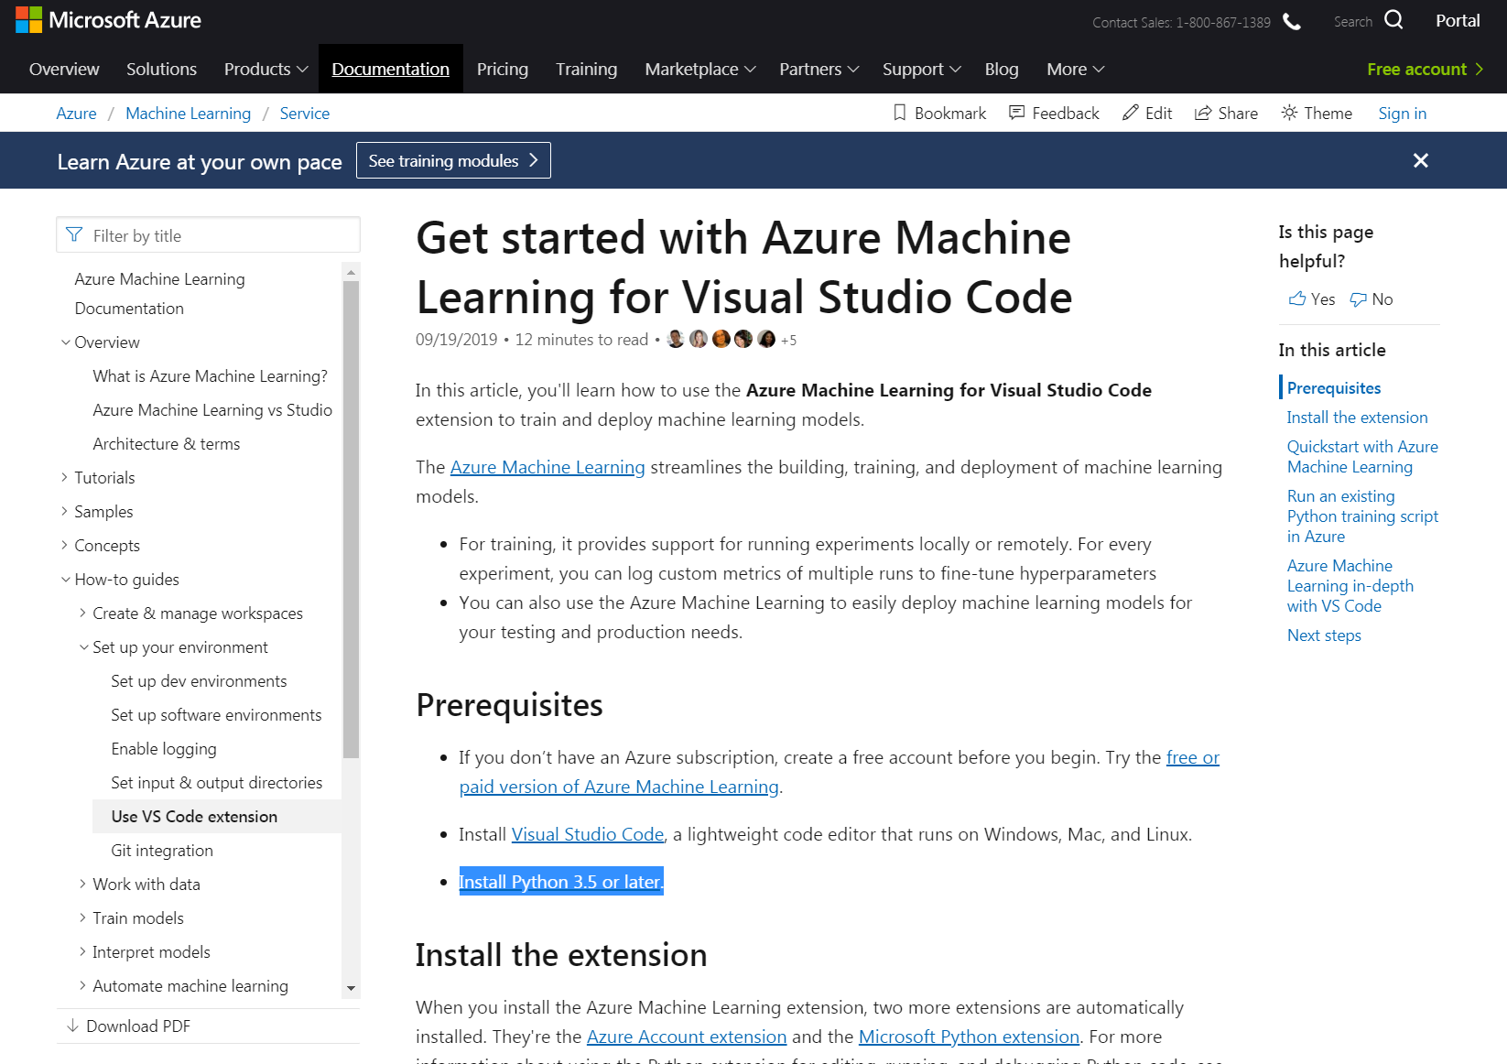
Microsoft’s Machine Learning Tool

Slide 48
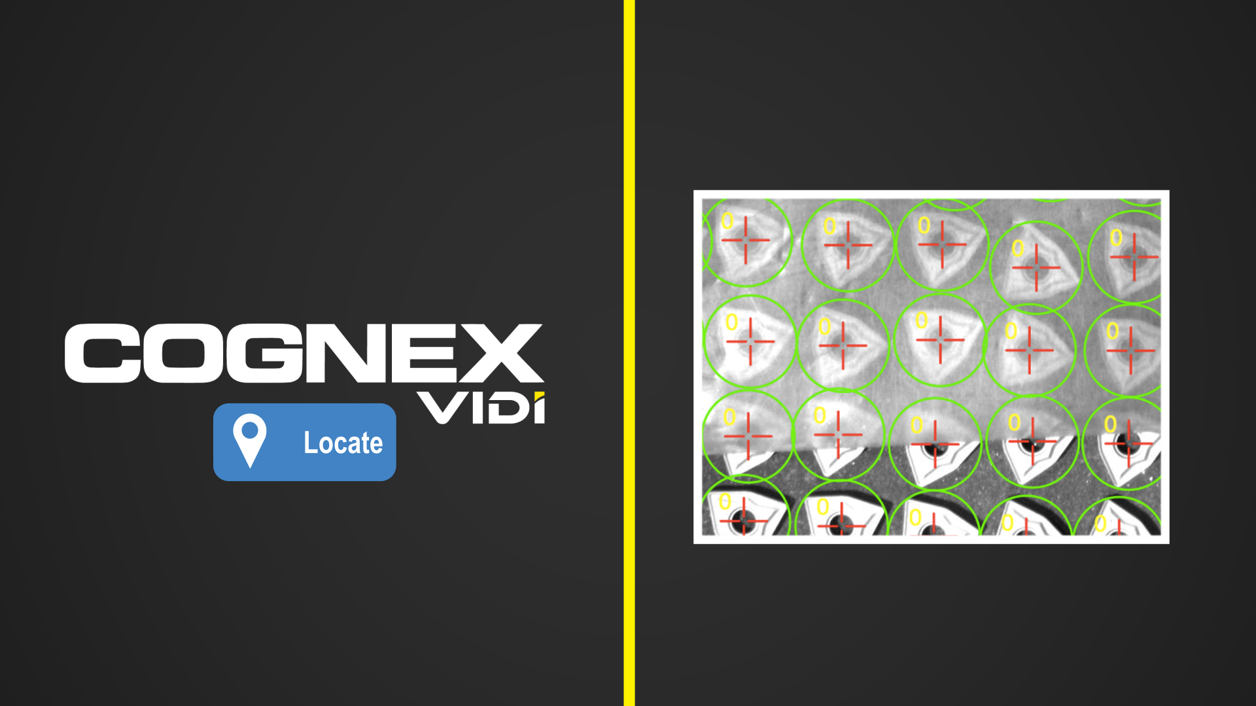
Cognex Vidi
Cognex Uses ViDi, Proprietary Deep Learning software

Slide 49
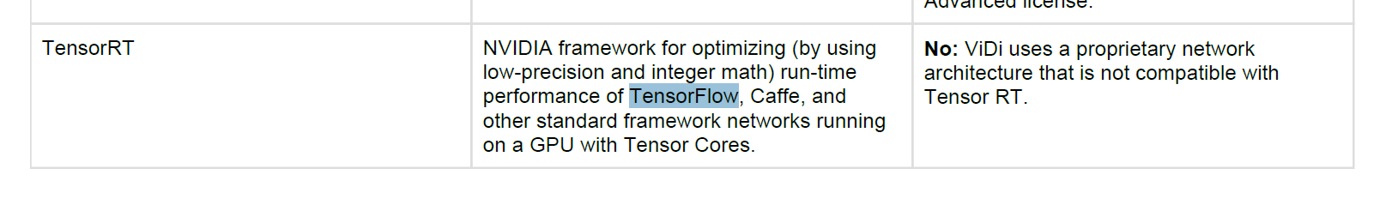
Cognex Vidi
ViDi’s “proprietary” algorithm is based on TensorFlow

Slide 50
Back to notebook

Slide 51
Source Material
https://github.com/cshaley/bracketeer
https://www.kaggle.com/juliaelliott/basic-starter-kernel-ncaa-men-s-dataset

Slide 52
Conclusion!
Thanks for Attending
Will have again next year, so feedback is welcome!
Visit Kaggle.come to learn more

